Slide 1

Social Network Analysis, explained
Josephine McKelvy, PhD

Slide 2



Agenda
Terminology
Data Collection
Measures

Slide 3




Introduction
With Social Network Analysis (SNA), you can explore how group structure (e.g., hierarchies, positions, roles), relationships (e.g., ties, links, connections), and homophily (“birds of a feather flock together”) influence outcomes like behaviors or the flow of resources.

Slide 4

Terminology
Subtitle

Slide 5
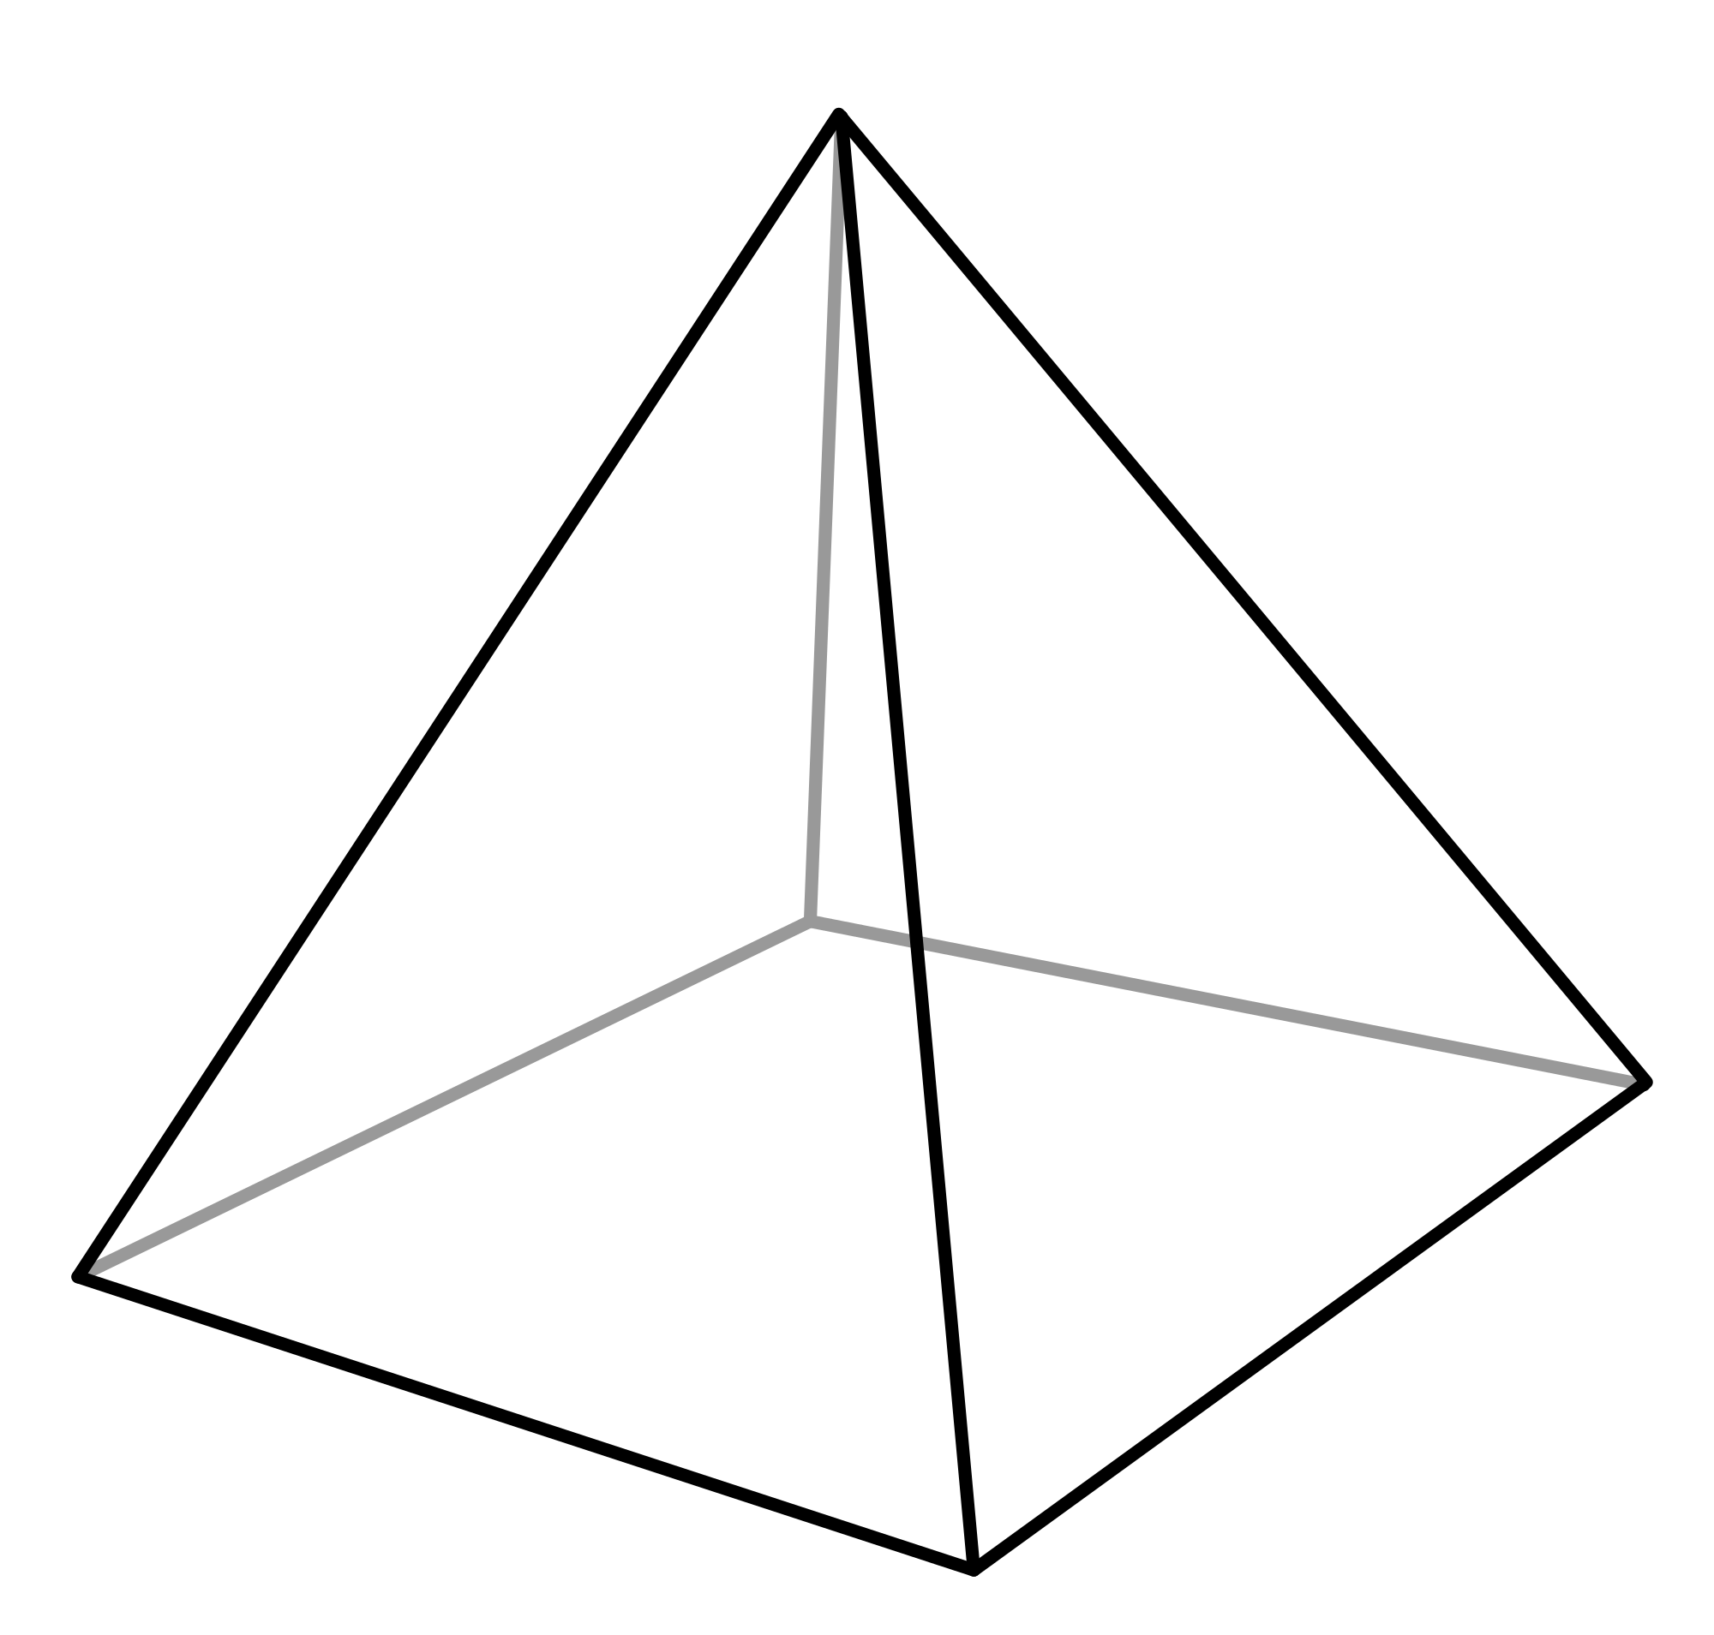
Terminology
Edge (or joining line)
Geometry & Polygons
Vertex (or corner)

Slide 6
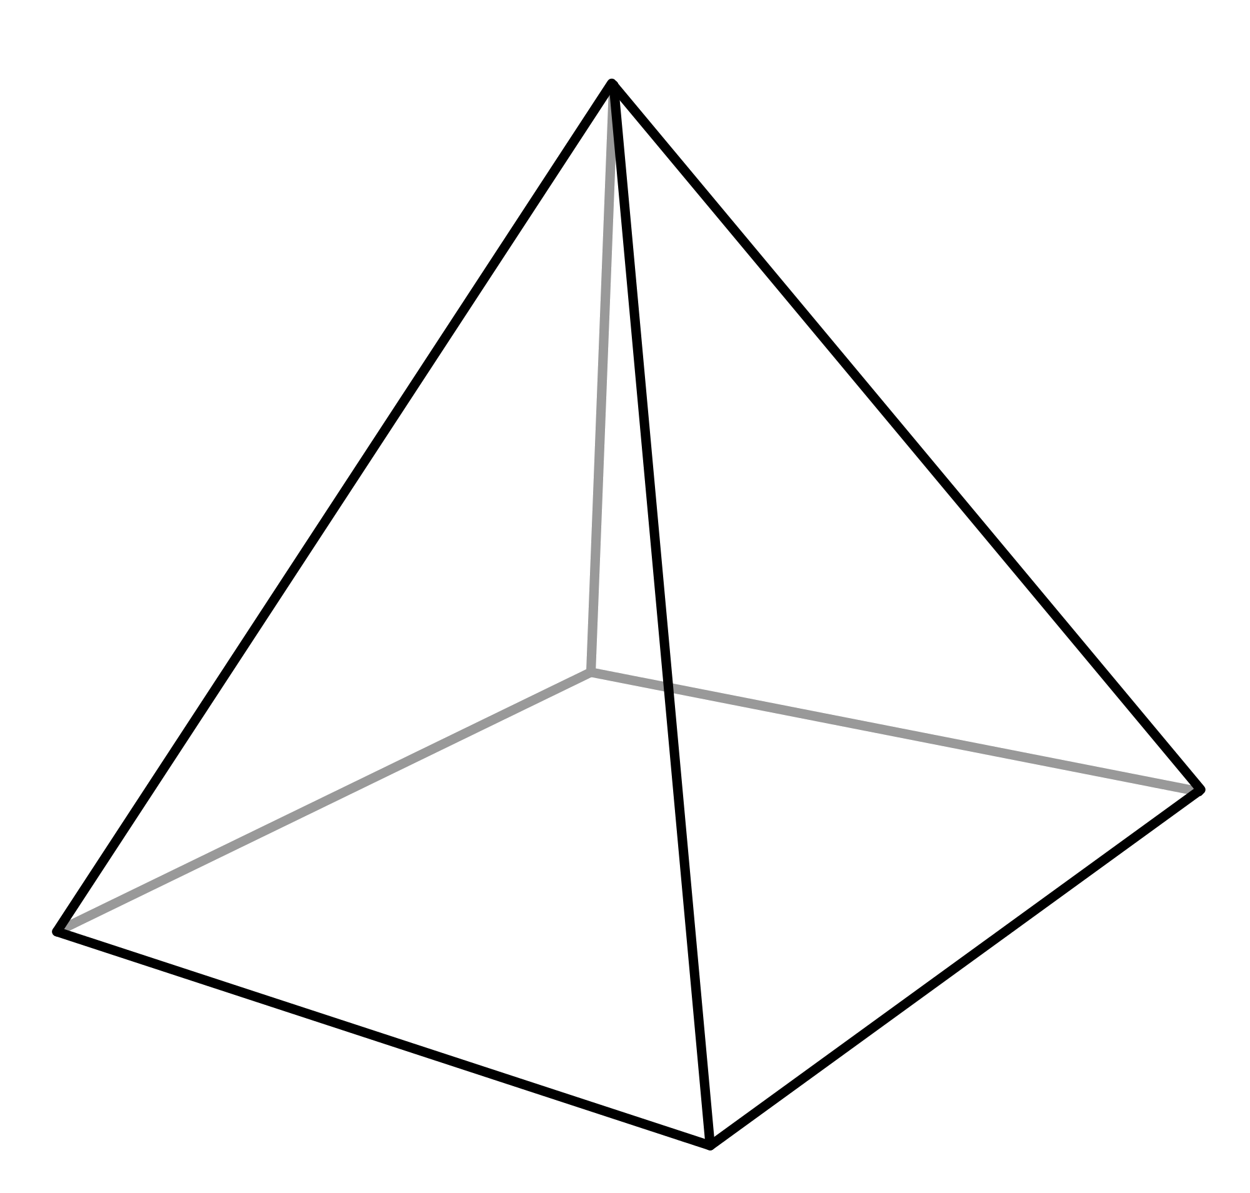
Terminology
Edge (or joining line)
Ties
Relations/Associations
Links/Connections
Flows
NETWORK: a set of interactions (edges) between objects (vertices)
Vertex (or corner)
Nodes
Actors
Organizations

Slide 7



Types of Ties
DIRECTED
UNDIRECTED
Relationships where DIRECTions matter, because they may not be reciprocal
Relationships that are bidirectional or reciprocal

Slide 8
Types of Ties
BINARY
VALUED
SIGNED
If a tie exists at all
Ties with varying strength/weakness
Ties with positive or negative sentiment
(Multiplex or strong tie)
+
-
-

Slide 9

Types of Graphs
ONE MODE
TWO MODE / BIPARTITE
Connections between one type or class of nodes
Connections between two types or classes of nodes

Slide 10
Data Collection
Subtitle

Slide 11

Data Collection
SURVEYS: Nominate X people you [insert verb] with.
INTERVIEWS: Who do you [insert verb] with under [insert conditions]?
“Name 3 people you would have lunch with.”

Slide 12
Data Structures: ADJACENCY MATRIX
a square matrix where the rows and columns are all possible VERTICES (i.e., nodes, actors, organizations), and each cell's value represents the absence (=0) or presence (=1) of a relationship between the two intersecting nodes; i.e., if a pair of nodes are ADJACENT to one another
 | Little Red Riding Hood | Grandma | Big, Bad Wolf
Little Red Riding Hood | (not available) | 1 | 0
Grandma | 1 | (not available) | 0
Big, Bad Wolf | 1 | 1 | (not available)

Slide 13
Data Structures: EDGE LIST
set of rows denoting EDGES (i.e., ties, relations, links, connections, flows) from sender to receiver that ignores the absence (=0) of a tie
isolates (who do not send out or receive a tie) are left out of the graph
(From)Sender/ Source | (To)Receiver/ Destination
Little Red Riding Hood | Grandma
Grandma | Little Red Riding Hood
Big, Bad Wolf | Grandma
Big, Bad Wolf | Little Red Riding Hood

Slide 14
Data Structures: NOMINATION LIST
set of rows including the sender, plus one receiver per column
each row is the observation collected from a respondent's nominations or list of [insert entities] they [insert verb] with
 | Nomination 1 | Nomination 2 | Nomination 3
Little Red Riding Hood | Grandma | - | -
Grandma | Little Red Riding Hood | - | -
Big, Bad Wolf | Little Red Riding Hood | Grandma | -

Slide 15
Measures
Subtitle

Slide 16
DEGREE
the number of edges for each actor
In degree: number of ties received (column sums)
Out degree: number of ties sent (row sums)
 | Little Red Riding Hood | Grandma | Big, Bad Wolf | Row Sums
Little Red Riding Hood | (not available) | 1 | 0 | 1 ties sent out
Grandma | 1 | (not available) | 0 | 1 ties sent out
Big, Bad Wolf | 1 | 1 | (not available) | 2 ties sent out
Column Sums | 2 received in | 2 received in | 0 received in

Slide 17
DENSITY
the ratio between actual ties and possible ties in the network
Possible ties = Nodes × (Nodes - 1) = 3 × 2 = 6 possible ties
Density = actual / possible ties = 3 actual / 6 possible = 0.5
One being high density, or direct connections
Zero being low density

Slide 18
WALK
a sequence of nodes and edges (backwards and forwards) that connect actor i to actor j, of a given length between i and j
There is a walk of length 1 between Little Red Riding Hood and Grandma.
By raising the matrix to the Nth power, we get the number of walks of length N between all ij pairs.
To calculate walks of length 3 between all pairs, multiply: adjacency matrix × adjacency matrix × adjacency matrix
Notes:
Within a network that is less fragmented, a new or corrected piece of information (or contagion) can flow more easily
Closure: “The friend of my friend is likely to be my friend.”

Slide 19
PATH
a sequence of nodes and edges, starting with one node and ending with another, without repeating or retracing steps

Slide 20
DISTANCE
(a matrix of) the shortest paths between nodes in a network
Mean, Median
On average, the shortest path between any two actors in this network is a path of length 1.
 | Little Red Riding Hood | Grandma | Big, Bad Wolf
Little Red Riding Hood | (not available) | 1 | 1
Grandma | 1 | (not available) | 1
Big, Bad Wolf | 1 | 1 | (not available)

Slide 21
REACHABILITY
whether actor i can reach actor j through any path with a length that is less-than infinity

Slide 22
CLOSENESS
the inverse of the distance matrix when there are unreachable pairs.
By inverting the distance matrix, all unreachable pairs (with infinite steps) are turned into zeroes and thus can be included in the mean calculation.
= 1 / distance matrix

Slide 23
DIAMETER
the longest distance between any two nodes in the network, excluding unreachable pairs

Slide 24


Thank You
Josephine McKelvy, PhD
Josephine.mckelvy@gmail.com
Josephinemckelvy.wordpress.com

Slide 25
Chart

Slide 26
Table
 | Category 1 | Category 2 | Category 3 | Category 4
Item 1 | 4.5 | 2.3 | 1.7 | 5
Item 2 | 3.2 | 5.1 | 4.4 | 3
Item 3 | 2.1 | 1.7 | 2.5 | 2.8
Item 4 | 4.5 | 2.2 | 1.7 | 7

Slide 27

The way to get started is to quit talking and begin doing.
Walt Disney

Slide 28




Team
Name
Name
Name
Name
Title
Title
Title
Title

Slide 29
Timeline
Title
To start a presentation, go to the Slide Show tab, and select From Beginning.
Title
To display Presenter view, in Slide Show view, on the control bar at the bottom left select the three dots, and then Show Presenter View.
Title
During your presentation, the speaker notes are visible on your monitor, but aren't visible to the audience.
Title
Title
If you don’t see the Notes pane or it is completely minimized, click Notes on the task bar across the bottom of the PowerPoint window.
The Notes pane is a box that appears below each slide. Tap it to add notes.

Slide 30

Summary
With PowerPoint, you can create presentations and share your work with others, wherever they are. Type the text you want here to get started. You can also add images, art, and videos on this template. Save to OneDrive and access your presentations from your computer, tablet, or phone.

